Slide 1
Introduction to
Volunteered Geographic Information
Wednesday, November 8, 2017
Kent Jacobs

Slide 2
What is Geographic Information?
Longley et al. 1999
  Defined as information pertaining to real-life features located on the surface of the Earth
This information is crucial to help us solve real life issues
Collected, gathered and stored by government departments or private companies

Slide 3
What is Volunteered Geographic Information?
Goodchild 2007
  Created
  Collected
  Circulated
…on a volunteer basis!

Slide 4
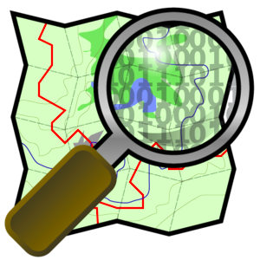


Types of Volunteered Geographic Information
Senaratne et al. 2016
Map-based
  OpenStreetMap
Image-based
  Instagram, Snapchat
Text-based
  Twitter

Slide 5

What is OpenStreetMap?
Founded in 2004 in London, England
Free world map (not just Canada)
Millions of contributors
Many mapping communities
“Wikipedia” of map

Slide 6
Use cases
Humanitarian aid
Pedestrian navigation
Journalism & politics
Environmental monitoring

Slide 7
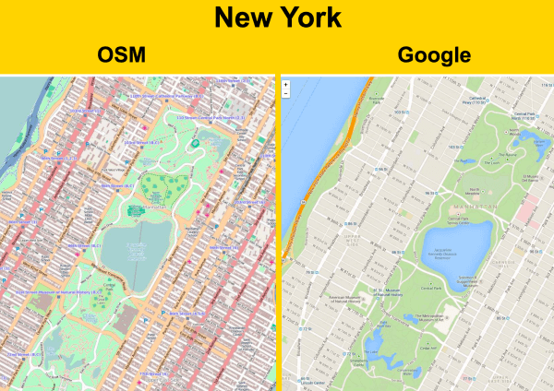

Slide 8
