Slide 1

Making sense of records

Slide 2
The story process
The idea
Research
Questions
Interviews
Sorting
What is the story?
What will help tell the story?
Flow
Fairness
Accuracy

Slide 3
Questions: When you receive documents
Return to your original notes and re-familiarize yourself with the issues
Go through the documents carefully in a quiet space
Upload them to DocumentCloud and annotate
If working with hard copies, don’t highlight but make notes in the margins

Slide 4
Questions: Decoding
Deciphering access records is a little like reading tea leaves: They are often a jumble, littered with strange acronyms and blacked-out (or whited-out) paragraphs, and lack titles, dates and information about who created the documents.
As you make notes, look up unfamiliar words and names.

Slide 5
A GLOBAL AFFAIRS CANADA DOCUMENT

Slide 6
Questions: Chronology
Creating a timeline of events can help patterns emerge and assist you in determining the story

Slide 7
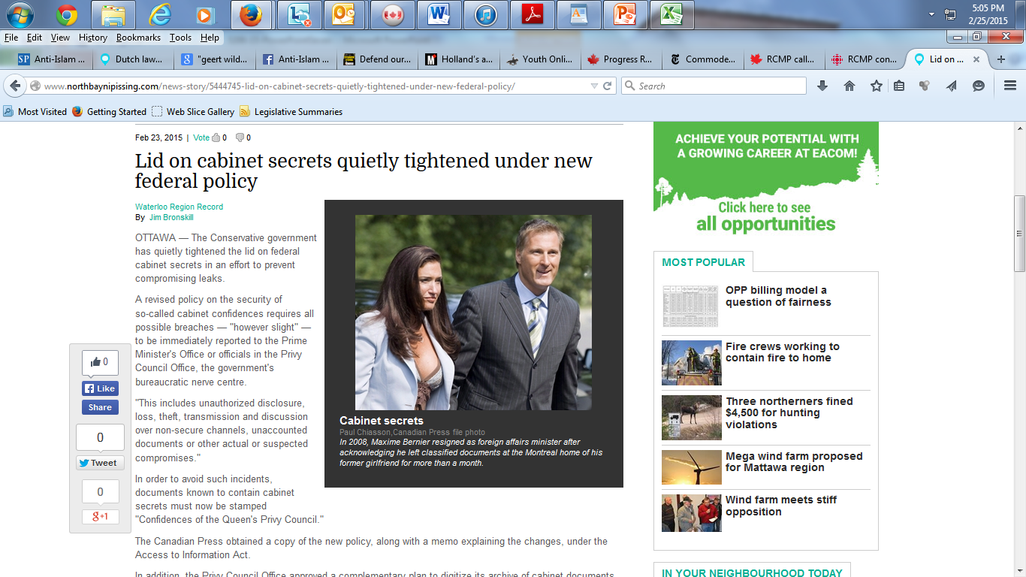

Slide 8
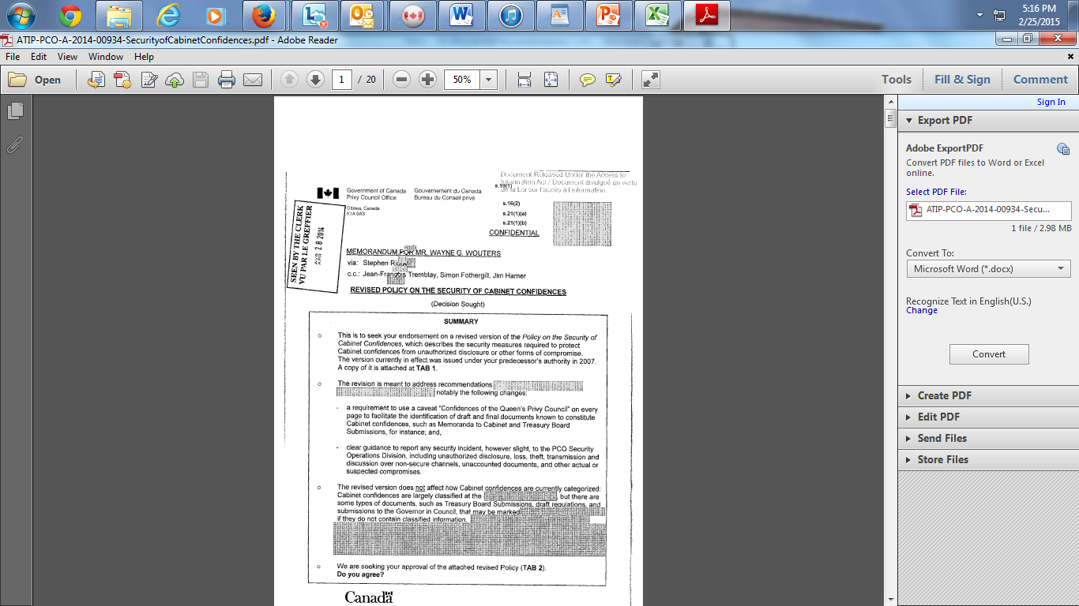

Slide 9
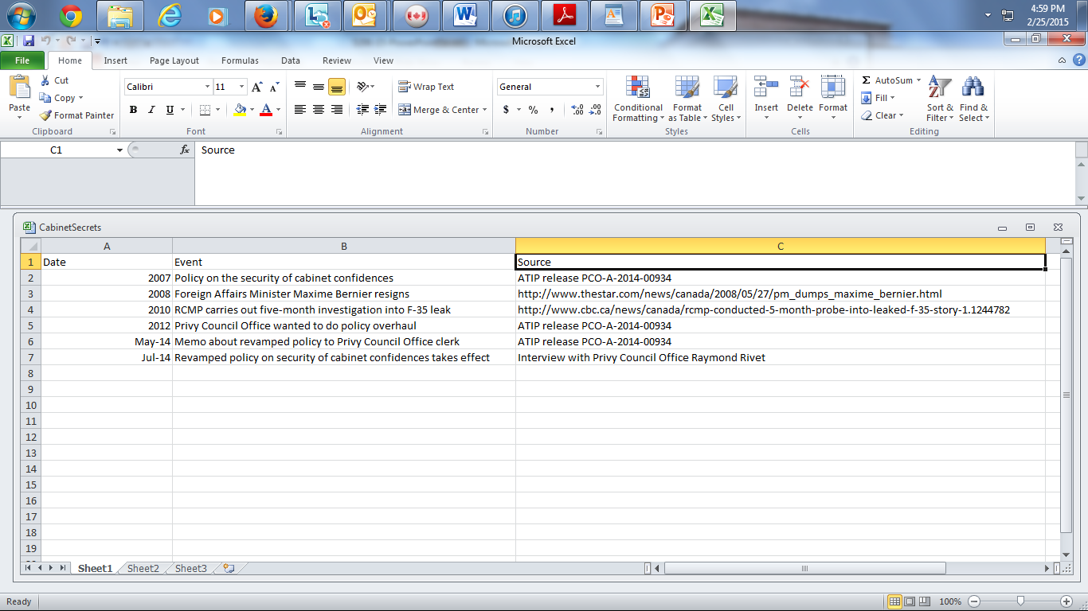

Slide 10
Questions: what’s new?
The new elements of the story should emerge after reviewing your research, notes and chronology
Now you have a basis on which to interview government officials and interested parties about the documents

Slide 11
Interviews
An access release can be a wedge that cracks open a story
It may well prompt a government agency to grant you an interview, even if only fragments of information have been disclosed
In fact, the agency may be eager to put those scraps of material into context. That foot in the door can lead to a wide range of questions

Slide 12
The story process: review
The idea
Research
Questions
Interviews
Sorting
What is the story?
What will help tell the story?
Flow
Fairness
Accuracy

