Slide 1

Access-to-information: making it work

Slide 2
Wording FREEDOM-of-information requests
Pay special attention to:
Time frame
Type of records
The key is striking a balance between wording that is too narrow and too broad

Slide 3
In general, asking for more than six months’ worth of records can be troublesome. And unless you have names, dates and places, requesting a specific letter or briefing note might be like looking for a needle in a haystack.

Slide 4
Including but not limited to…
For example:
Privy Council Office
Records from July 1, 2018, to the present concerning plans to renovate 24 Sussex Drive, including but not limited to briefing notes. However, I am not interested in emails.

Slide 5
Important wording
Possible additions:
Please do not process any records that appear to be cabinet confidences.
Please do not process any records that require consultation with external parties.

Slide 6
EXERCISE
Break into groups
Each group has 15 minutes to craft a request
Use the Access to Information fillable request form to come up with one federal request per group
Email the form to david_mckie@cbc.ca

Slide 7
MAKING A FEDERAL REQUEST ONLINE
https://atip-aiprp.tbs-sct.gc.ca/en/Home/Welcome

Slide 8
Make contact
Agencies will have a point person or co-ordinator, often served by a sizeable team, to process your application.
If you are unsure about your request, call the access co-ordinator before making a request. It is also a good idea to call or email the co-ordinator after submitting your request to see if it is sufficiently clear.

Slide 9
It is highly recommended that you...
Do as much advance research as possible to zero in on the kinds of documents you really want and avoid “fishing expeditions.”
Keep your requests focused.
Follow up with agencies once you have submitted requests – don’t just forget about them.

Slide 10
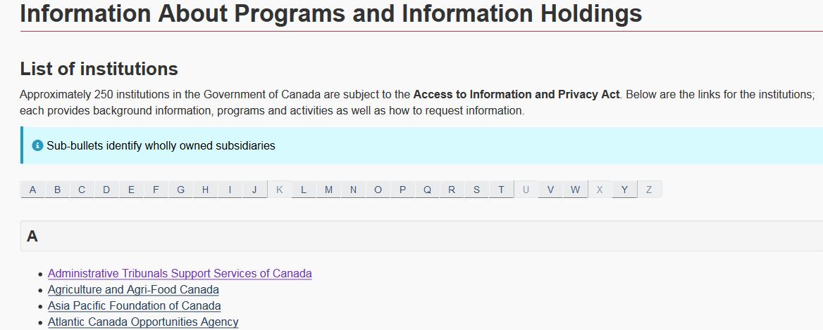
https://www.canada.ca/en/treasury-board-secretariat/services/access-information-privacy/access-information/information-about-programs-information-holdings/sources-federal-government-employee-information.html

Slide 11
A few tips…
Many public issues touch on various departments, so make similar requests to more than one agency or government.
Keep a photocopy or scan of each request and attach / save all return correspondence.
Negotiate with agencies. Your request isn't carved in stone. Wording can be altered after you send it off, though substantial revisions will restart the processing clock.

Slide 12
Plan B: Seeking previously released Access to Information records
One: Ask the agency where you submitted a request whether there are any recently released or about-to-be-released records on your topic. You can “piggyback” on another person’s request.
Two: If the first step doesn’t work, seek out documents from one of the lists of previously released records.
Tip: Allow time to order and receive them, which can take weeks. Some agencies are quicker than others.

Slide 13
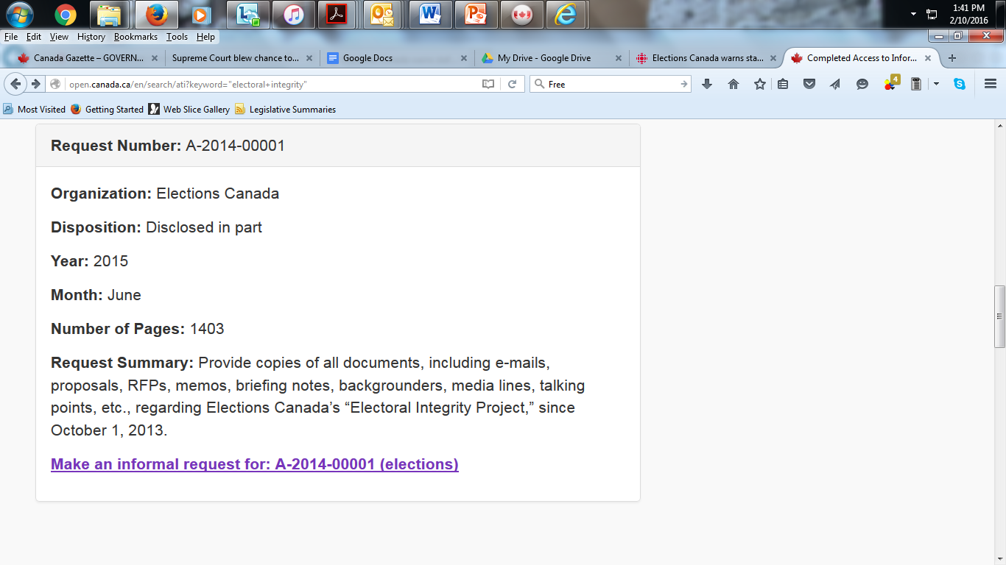
Completed request listing: Elections Canada

Slide 14
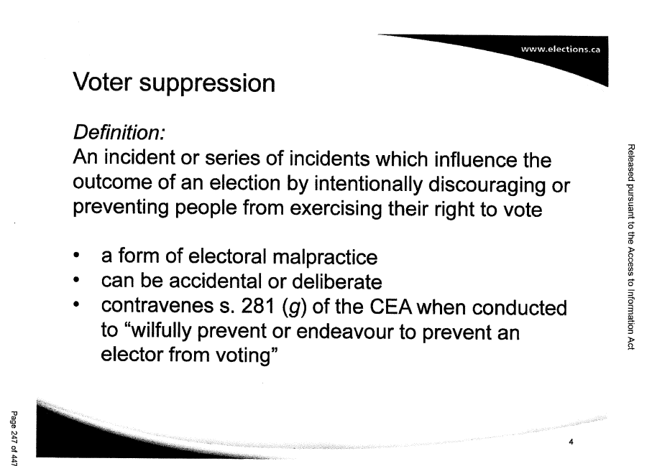
The Elections Canada records

Slide 15
Obtaining previously released federal records
Completed Access to Information requests
http://data.gc.ca/eng/search/ati?

Slide 16
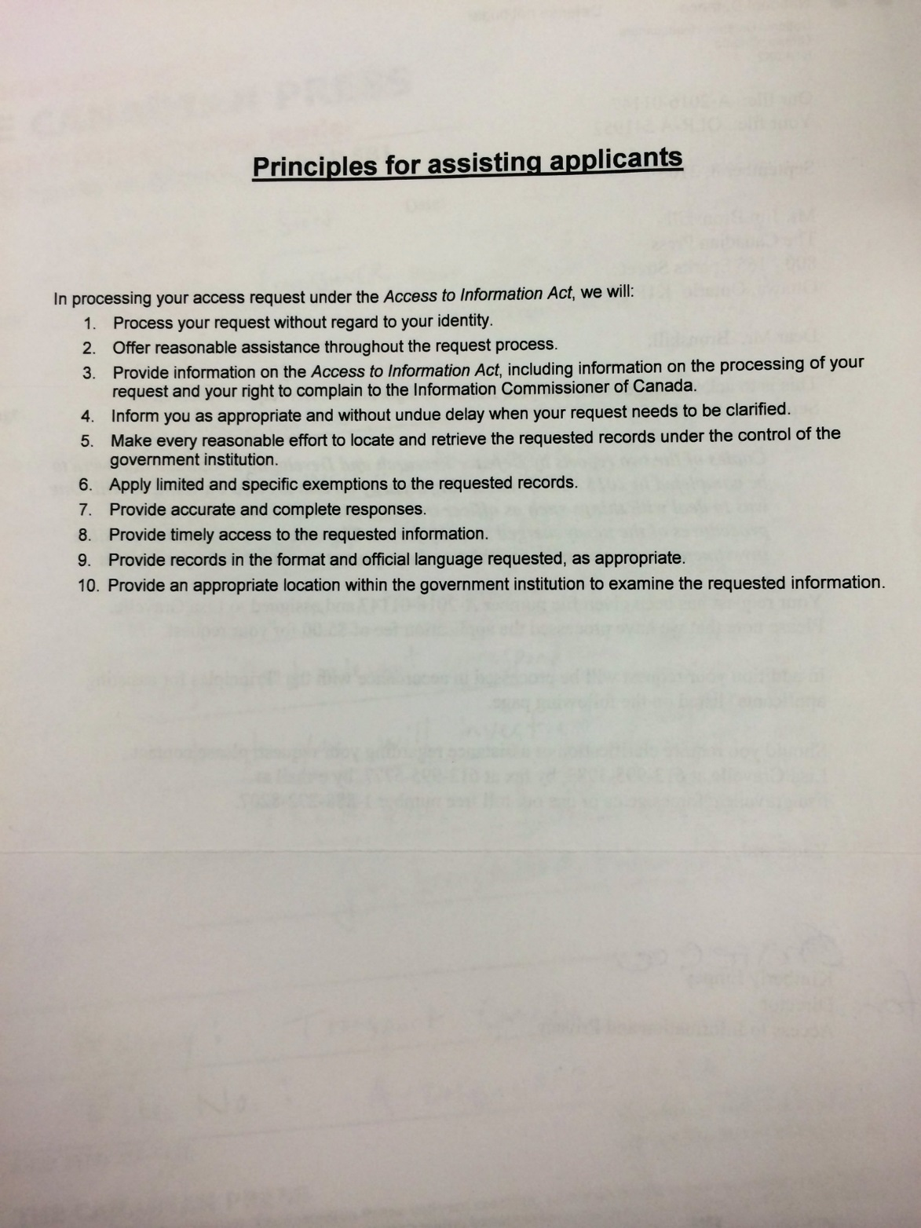

Slide 17
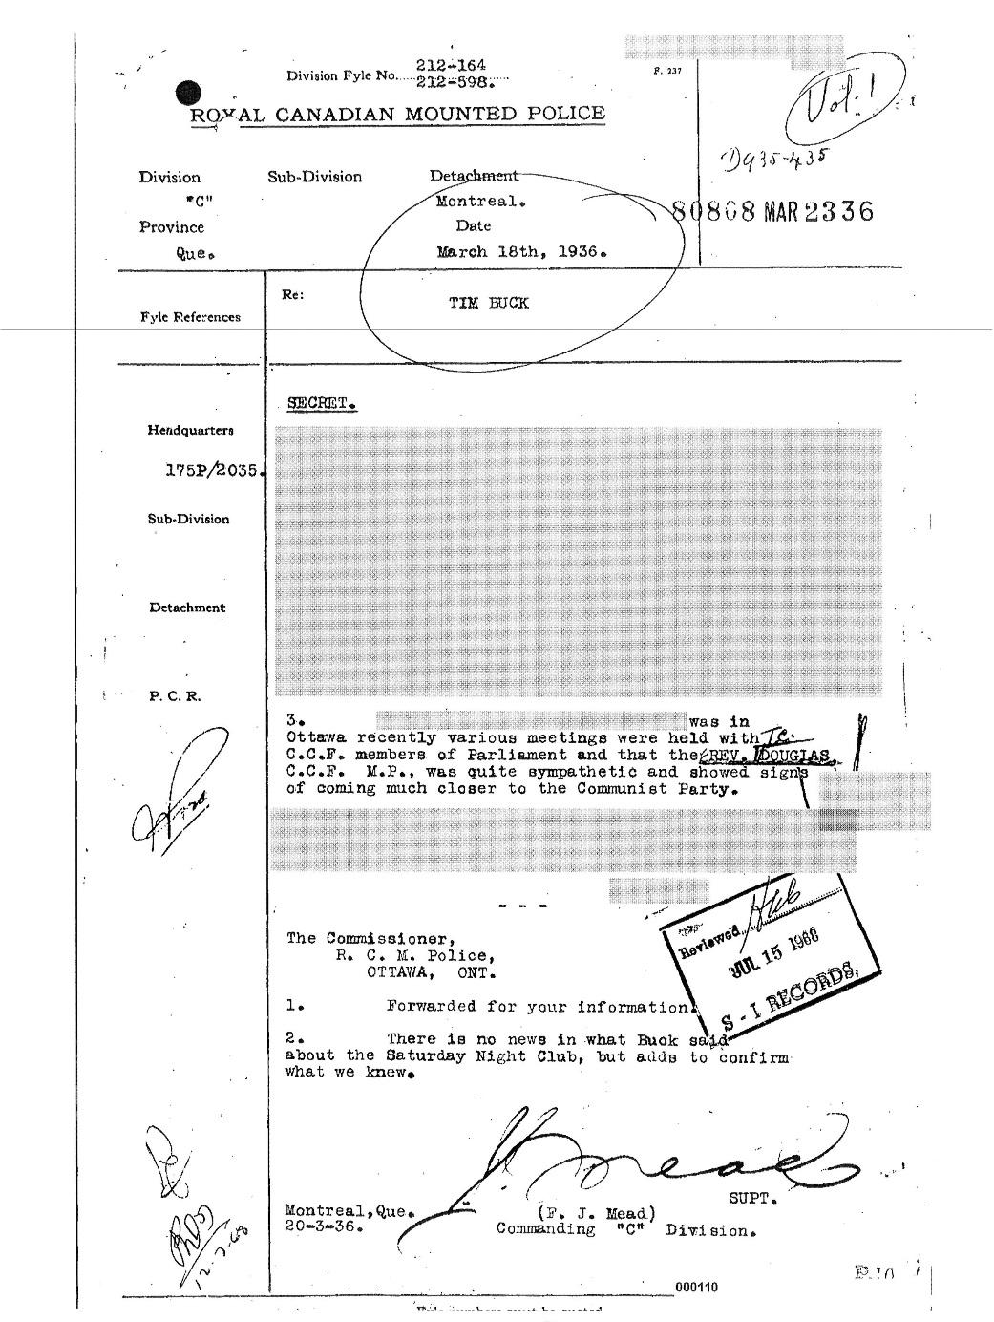
Exemptions

Slide 18
What you cannot get
Some exemptions
National security or international relations
Information related to a police investigation
Notes produced by lawyers
Personal information about someone
Commercial confidences provided by a business
Material concerning federal-provincial discussions
Exclusions
Cabinet documents that are less than 20 years old: usually completely off-limits

Slide 19
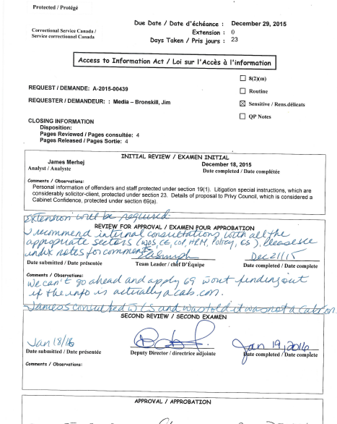
A GLIMPSE BEHIND THE SCENES…

Slide 20
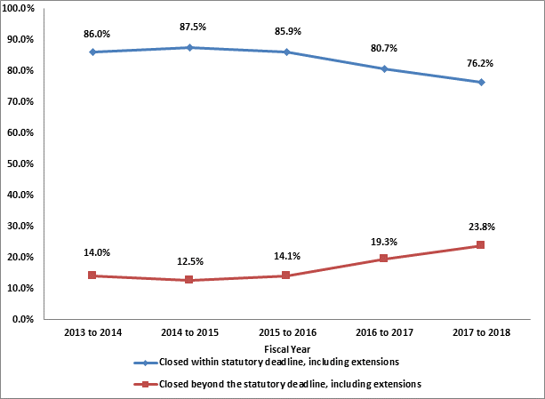
FEDERAL TIMELINESS: LAST FIVE YEARS

Slide 21
Interim releases
If an agency takes a lengthy extension, you can request that it do an “interim release” – that is, disclose any records that do not require consultation with others
Then the agency can provide you with a “final release” once the consultations on the remaining pages are complete

Slide 22
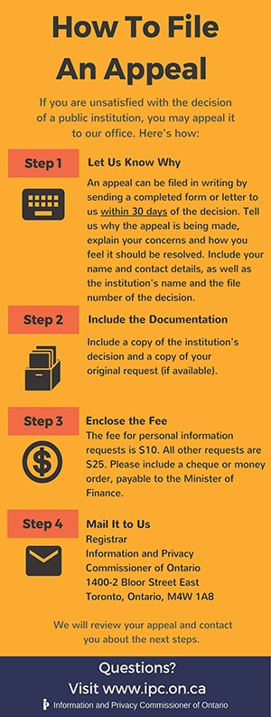

Slide 23
Reasons to complain
Excessive time extensions
Undue delays in processing a request
Fees
Poor service
Exemptions: Must complain within 60 days of receiving records

Slide 24

Complaints

Slide 25
http://www.oic-ci.gc.ca/
The Information Commissioner investigates complaints from people who believe they have been denied rights under the Access to Information Act — Canada's freedom of information legislation. An independent ombudsman appointed by Parliament, the Information Commissioner has strong investigative powers and mediates between dissatisfied applicants and government institutions.
As an ombudsman, the commissioner may not order a complaint resolved in a particular way. Thus the commissioner relies on persuasion to solve disputes, asking for a Federal Court review only if an individual has been improperly denied access and a negotiated solution has proved impossible.

Slide 26
Provincial / territorial / municipal complaints
Various levels of government have different mechanisms for complaining
Check the relevant websites for complaint procedures

Slide 27
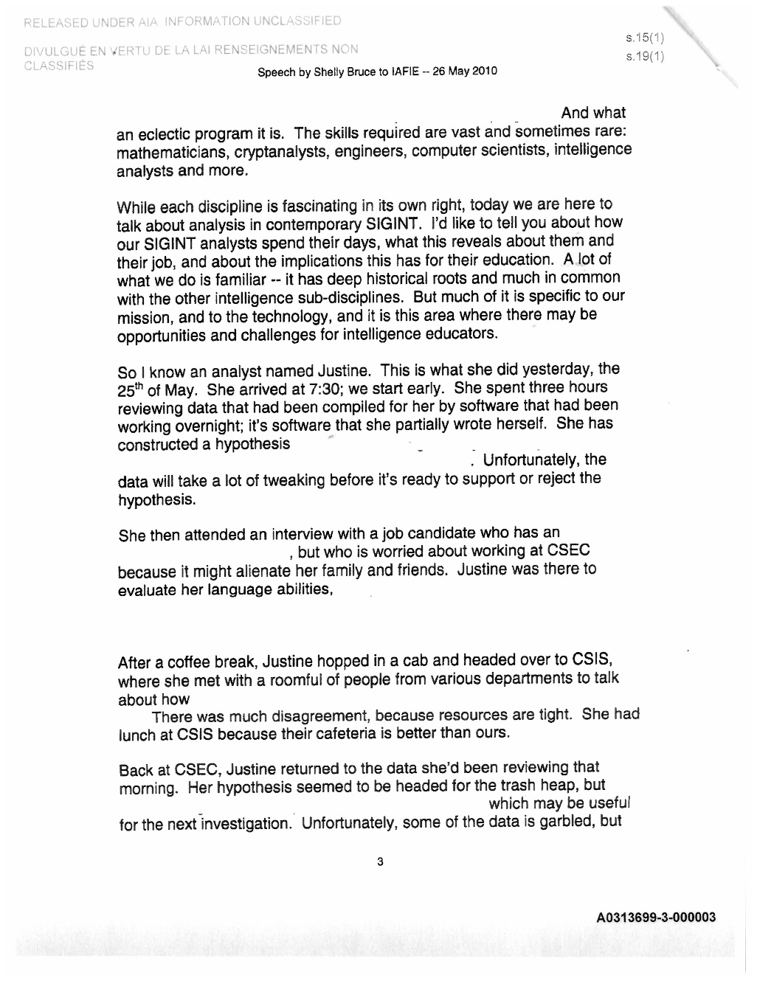
Communications Security Establishment Canada speech: Original release

Slide 28
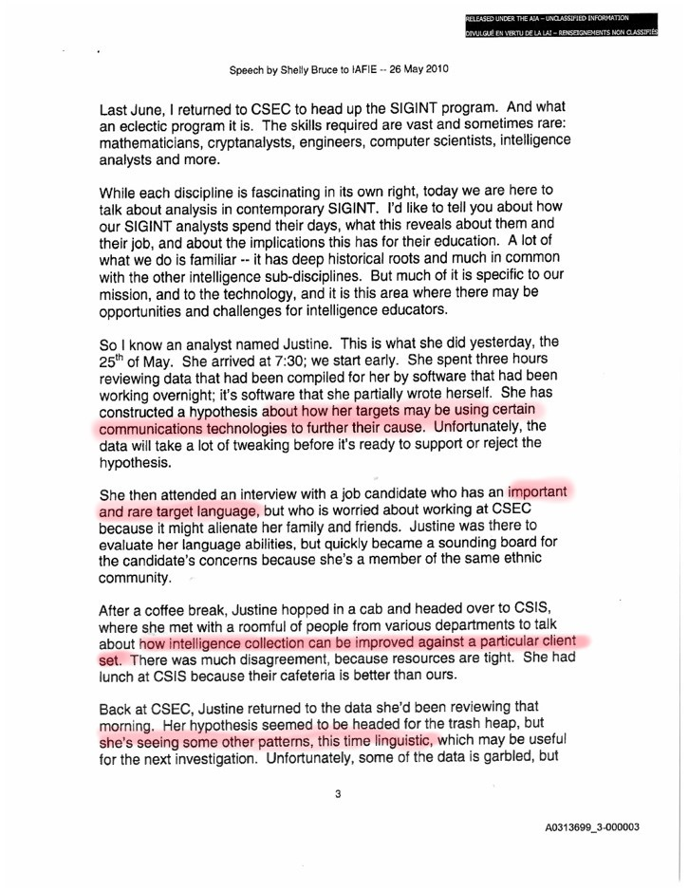
Communications Security Establishment Canada speech: Release following complaint

Slide 29
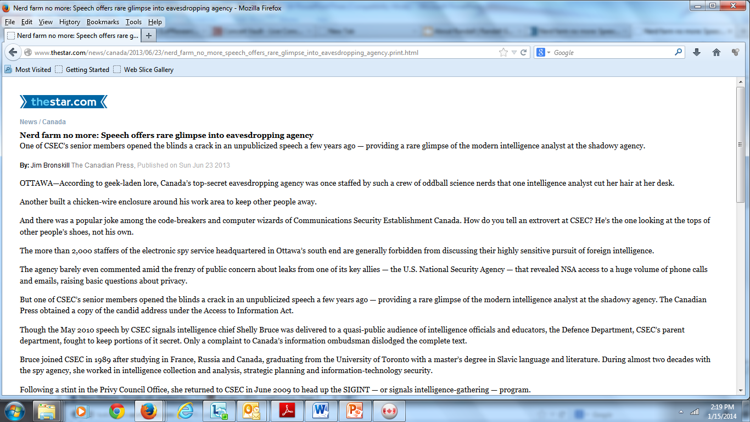
The STORY

Slide 30
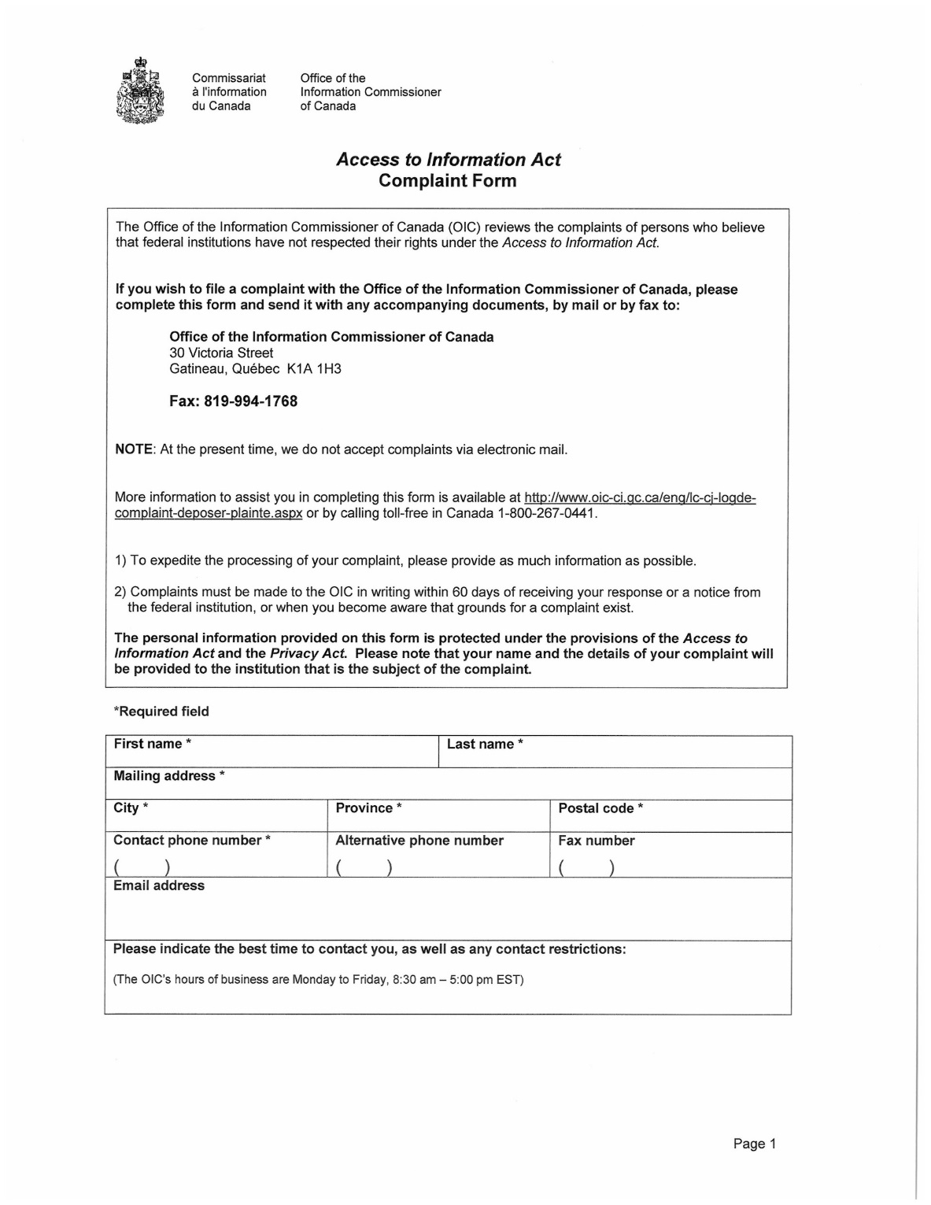
Federal complaint form

Slide 31
Online federal complaint form
http://www.oic-ci.gc.ca/eng/lc-cj-logde-complaint-deposer-plainte.aspx

Slide 32
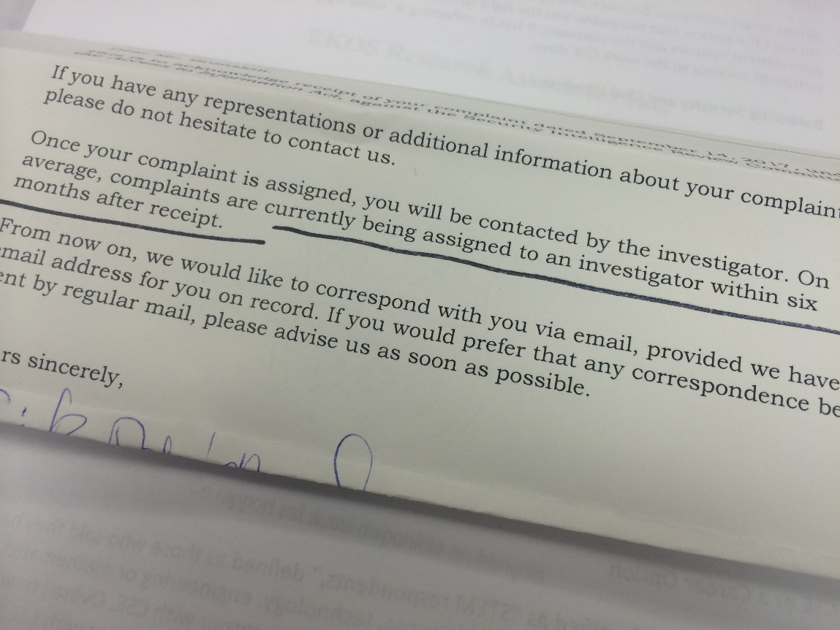
COMPLAINT DELAYS

