Slide 1
Obtaining previously released federal records
Completed Access to Information requests
http://open.canada.ca/en/search/ati

Slide 2
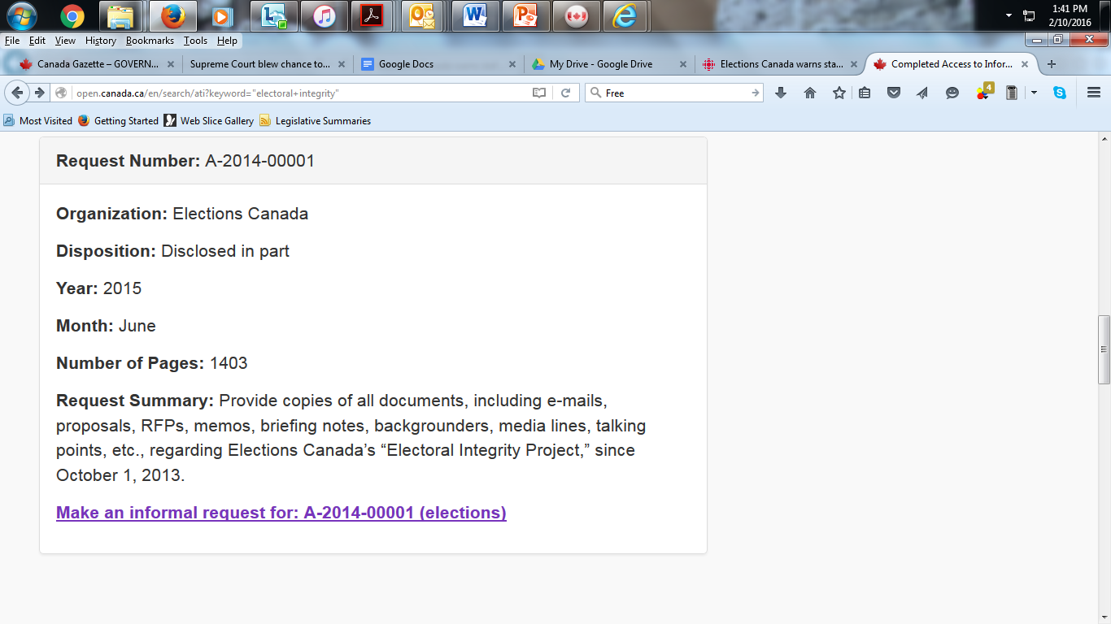
Completed request listing: Elections Canada

Slide 3
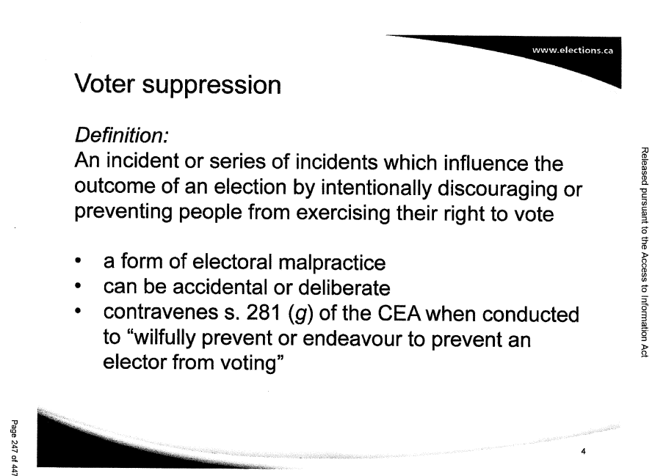
The Elections Canada records

Slide 4
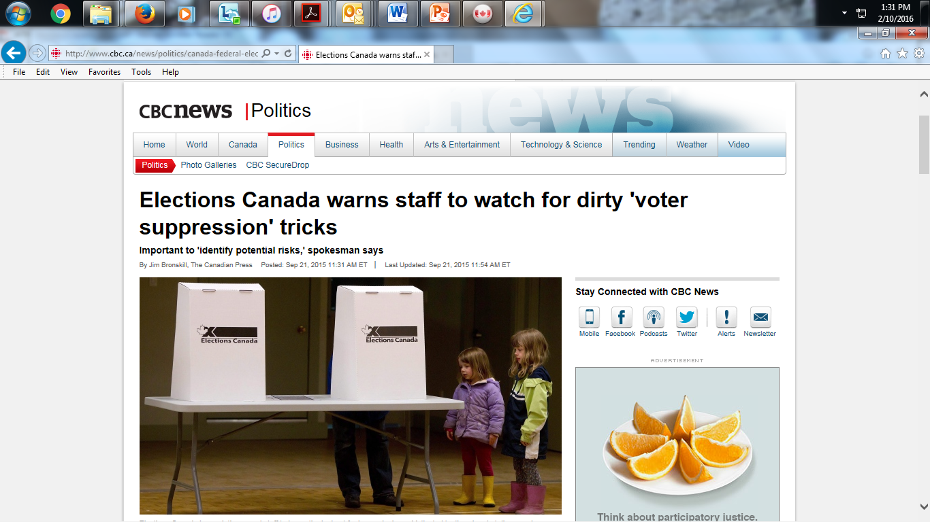
The story

Slide 5
OTHER Completed requests
CBC
http://www.cbc.radio-canada.ca/en/reporting-to-canadians/transparency-and-accountability/access-to-information/documents-released-in-answer-to-ati-requests-of-general-interest/
British Columbia
http://www2.gov.bc.ca/gov/search?id=4BAD1D13C68243D1960FECBBF7B8B091
Manitoba
http://www.gov.mb.ca/government/proactive_disclosure.html
Newfoundland
http://atipp-search.gov.nl.ca/

Slide 6
Federal agencies…
… that respond promptly to requests for previously released records:
Public Safety
National Defence
Global Affairs Canada
Privy Council Office
Communications Security Establishment
Office of the Privacy Commissioner
Office of the Information Commissioner
Fisheries and Oceans Canada

Slide 7
Federal Agencies…
… that DO NOT respond promptly to requests for previously released records:
Transport Canada
Health Canada

Slide 8
For the ACCESS STORY…
You may:
Obtain your own records through an original request.
Use records released to a previous requester through the federal or provincial laws.
Choose from records I will post to the syllabus in coming weeks.
Tip: Please make several requests for previously released files and sift through the ones available online. These will be the most likely sources of records for your story, given the short time-frame.
Please discuss your ideas with me well before the outline is due March 13.

