Slide 1


Slide 2
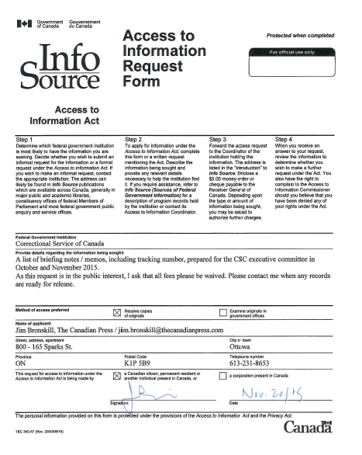
A request

Slide 3
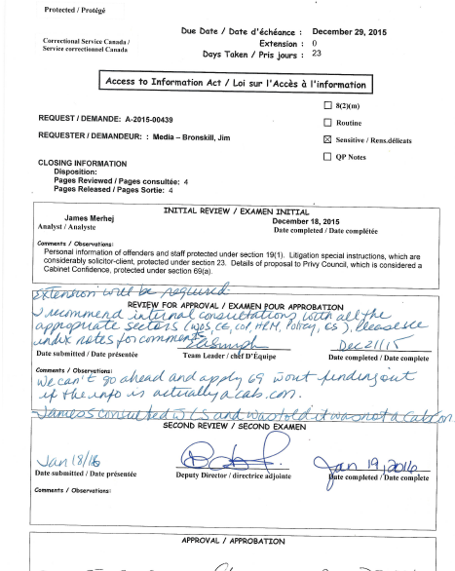
A GLIMPSE BEHIND THE SCENES…

Slide 4
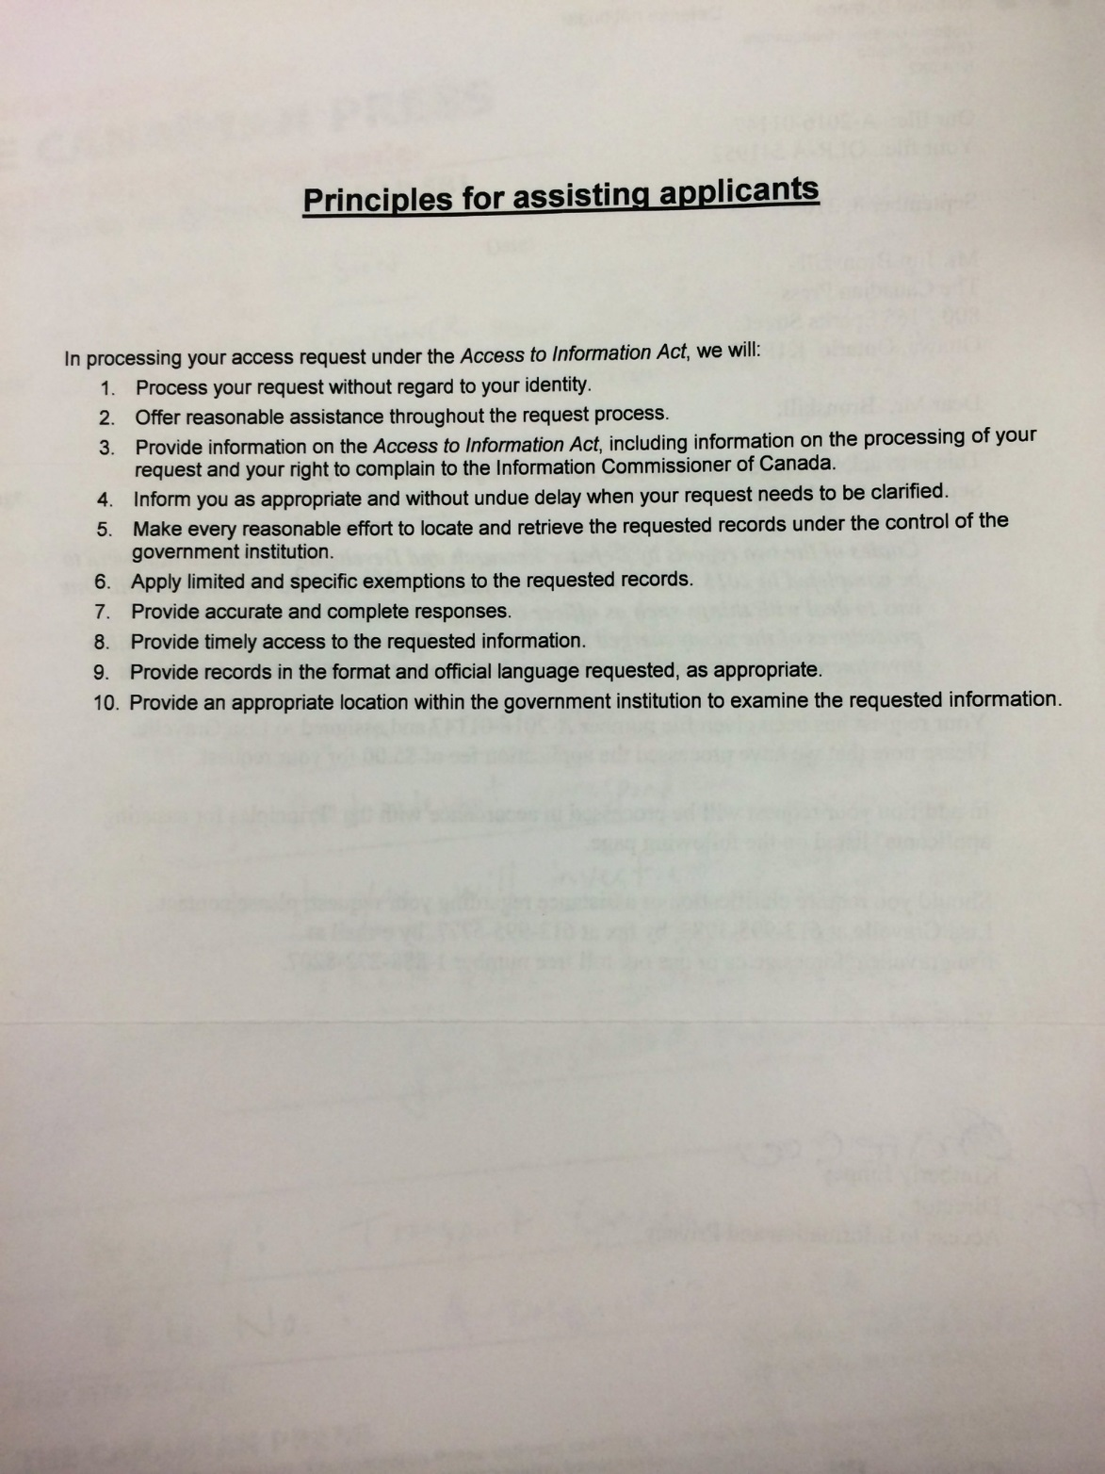

Slide 5
Negotiating with departments
Wording can be changed to narrow or broaden the scope of your request
Your request can be narrowed to avoid paying large fees
You can request an interim release of records not subject to extensive vetting or time-consuming consultations with other departments or outside parties

Slide 6

Complaints

Slide 7
http://www.oic-ci.gc.ca/
The Information Commissioner investigates complaints from people who believe they have been denied rights under the Access to Information Act — Canada's freedom of information legislation. An independent ombudsman appointed by Parliament, the Information Commissioner has strong investigative powers and mediates between dissatisfied applicants and government institutions.
As an ombudsman, the commissioner may not order a complaint resolved in a particular way. Thus the commissioner relies on persuasion to solve disputes, asking for a Federal Court review only if an individual has been improperly denied access and a negotiated solution has proved impossible.

Slide 8
Reasons to complain
Excessive time extensions
Undue delays in processing a request
Fees
Poor service
Exemptions: Must complain within 60 days of receiving records

Slide 9
Provincial / territorial / municipal complaints
Various levels of government have different mechanisms for complaining
Check the relevant websites for complaint procedures

Slide 10
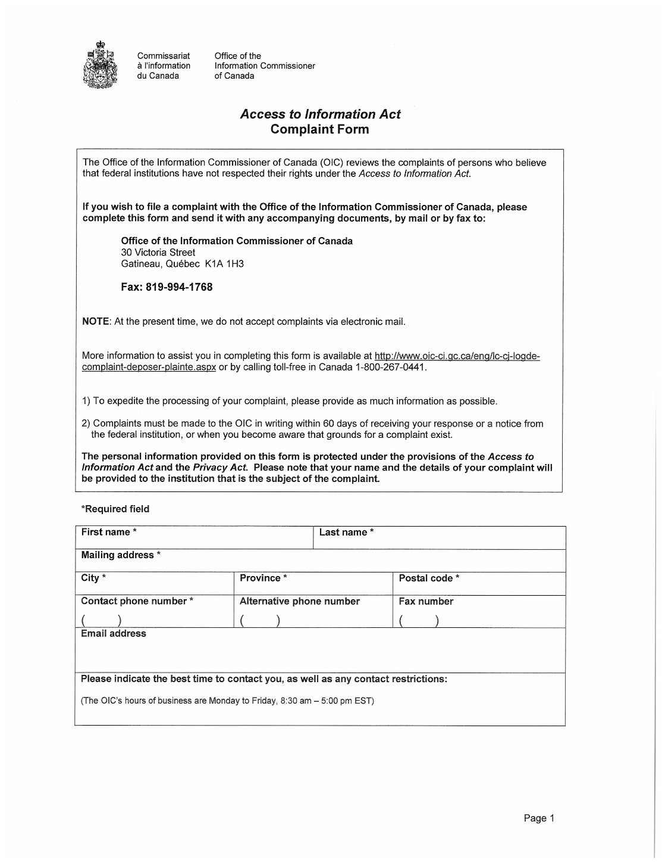
FEDERaL Complaint form

Slide 11
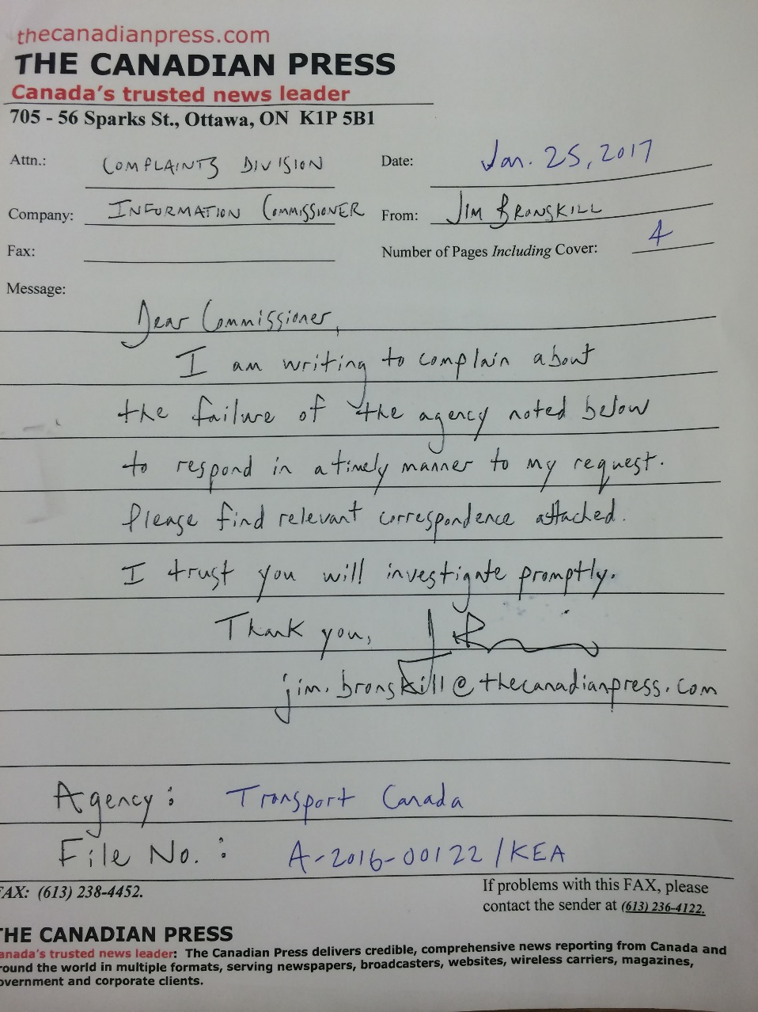
Complaint letter: keep it simple

Slide 12
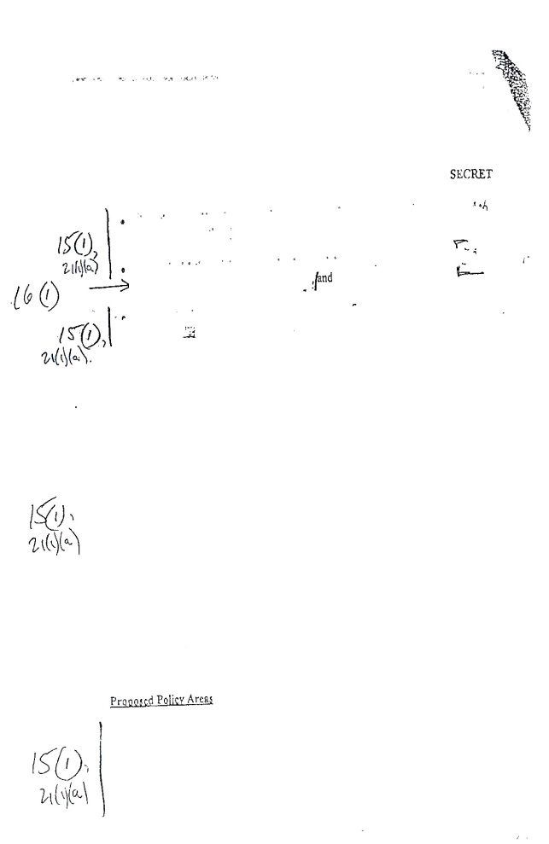
exemptions!

Slide 13
What you cannot get
Some exemptions
National security or international relations
Information related to a police investigation
Notes produced by lawyers
Personal information about someone
Commercial confidences provided by a business
Material concerning federal-provincial discussions
Exclusions
Cabinet documents that are less than 20 years old: usually completely off-limits

Slide 14
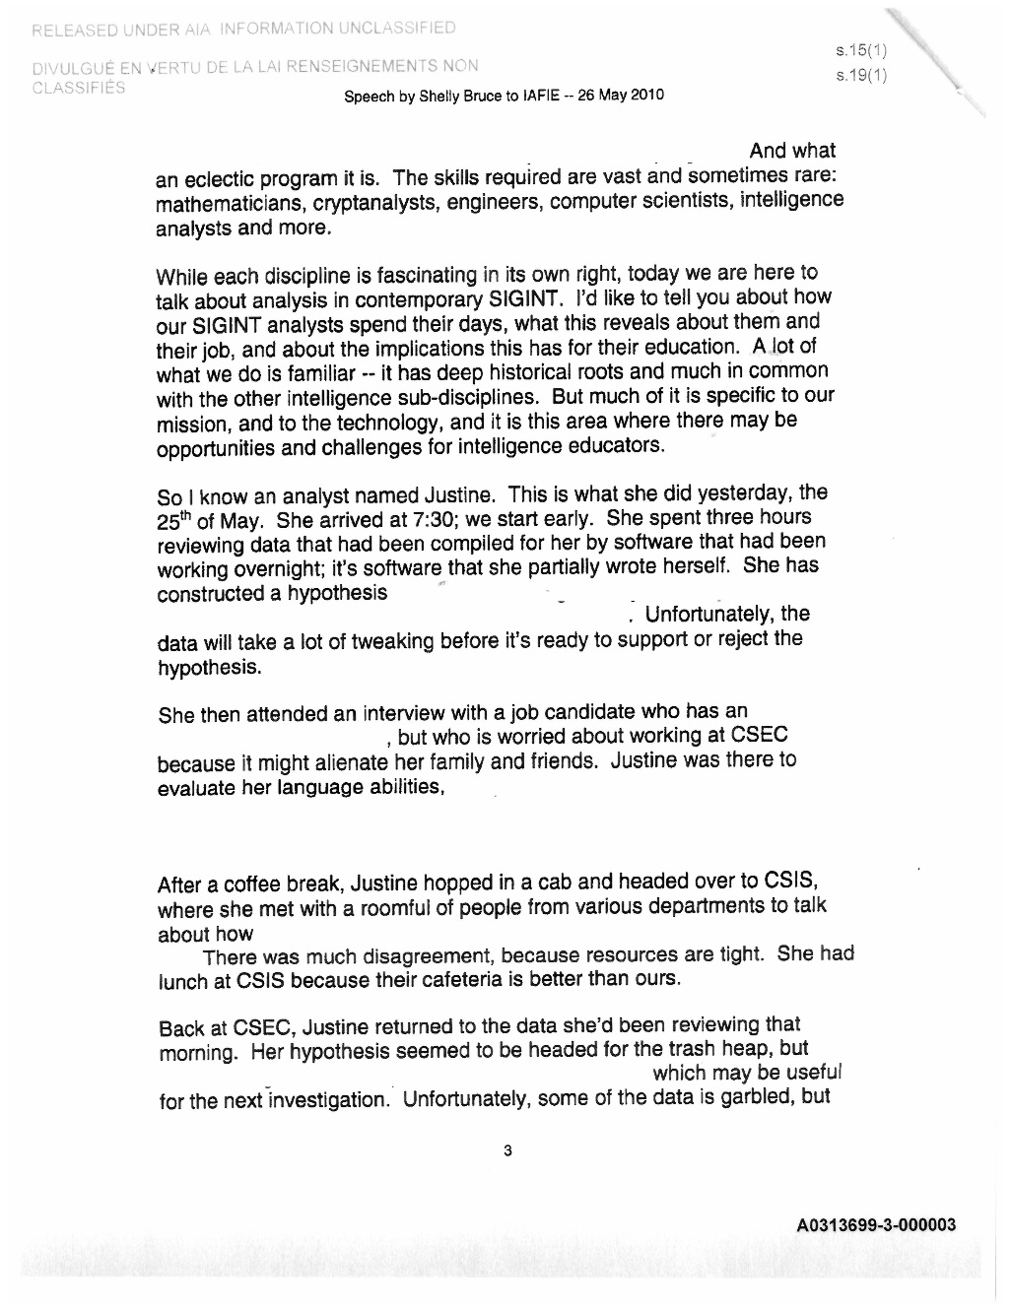
Communications Security Establishment Canada speech: Original release

Slide 15
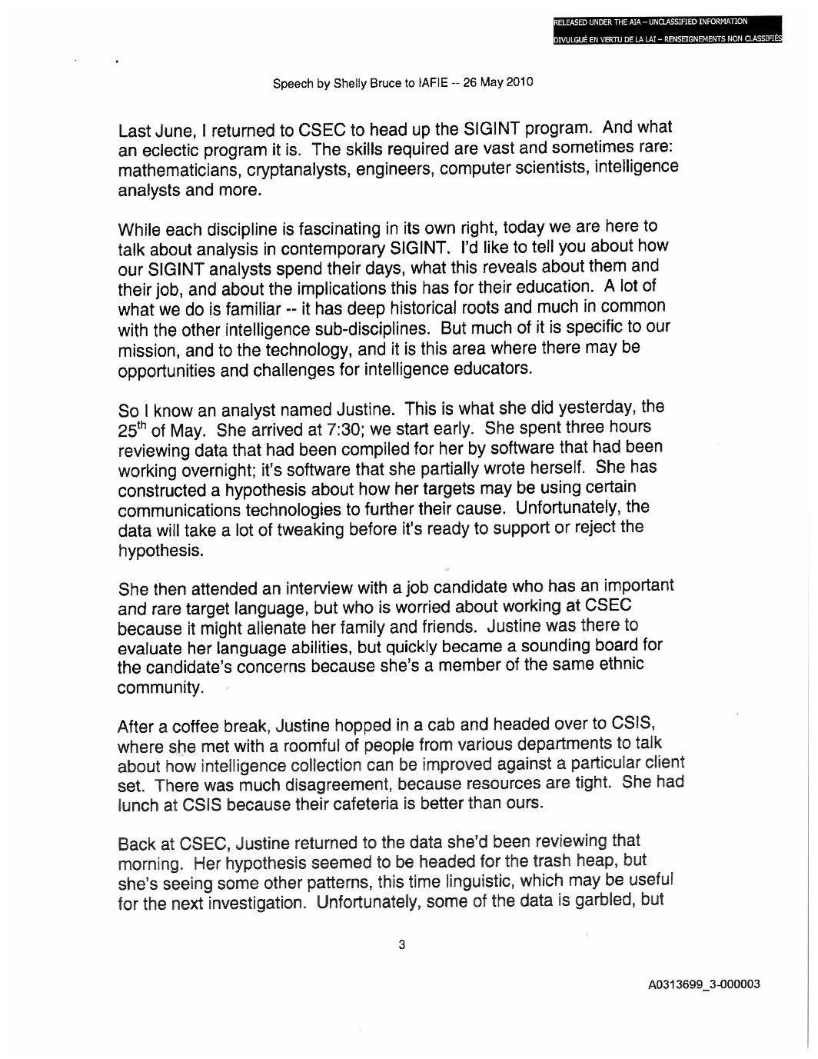
Communications Security Establishment Canada speech: Release following complaint

Slide 16
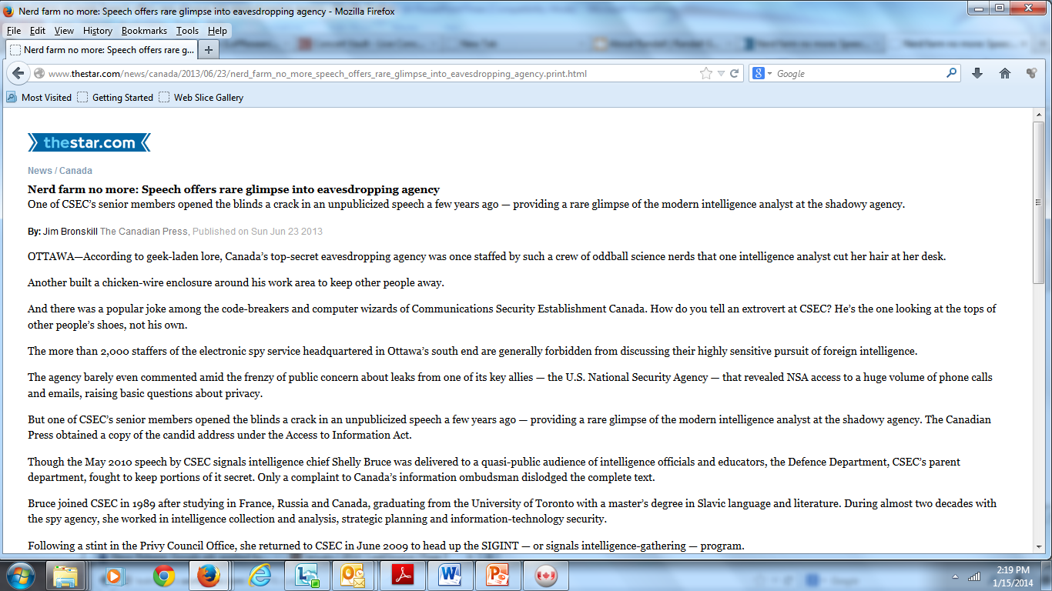
The STORY

Slide 17
Ten ways to improve your searches
1. Thoroughly research your topic: what do you really want to know? Which agency (or agencies) will have the information?
2. Check the relevant websites for forms, contacts, info on departmental holdings.
3. Call the access co-ordinator before making your request.
4. Call the co-ordinator after submitting your request.
5. Make similar requests to more than one agency or government.
6. Keep a copy of each request and attach all return correspondence.
7. Negotiate with agencies.
8. Be persistent. If necessary, complain.
9. Read the records you receive carefully.
10. Don't get discouraged.

